Slide 1



Bibliometris and research evaluation
An overview of current challenges
Vincent Larivière
Cassidy R. Sugimoto
vincent.lariviere@umontreal.ca
@lariviev
crc.ebsi.umontreal.ca

Slide 2
Outline
Transformation of research evaluation
Bibliometric data sources and limitations
A few bibliometric myths
Understanding Impact Factors
Adverse effects

Slide 3
Research evaluation
Traditional form: peer review
Peer review: process by which researchers submits her/his work, projects or track record to the scrutiny of experts in the same discipline
  Applied in almost all facets of academic life
    Publications
    Grants and scholarships
    Positions
    Tenure

Slide 4
Research evaluation (2)
Disadvantage of peer review
  Optimal size: individuals or small research groups
    Less efficient for larger, heterogeneous groups (countries, institutions)
  Subjective
  Costly
Bibliometrics is increasingly used to complement (and in some cases, supplement) peer review
Strong country / institution variations

Slide 5
Bibliometric data sources
No database is exhaustive
  Web of Science (about 34,000 journals)
  Scopus (about 40,000 journals)
  Dimensions (Crossref-based—about 4.5 million papers per year)
  Google Scholar and Microsoft Academic (online papers)
The do not provide identical results…
  High correlation
  Varies according to level of aggregration

Slide 6
Limitations
Challenge to find optimal point between exhaustiveness and access to data (i.e. WoS vs Google Scholar)
Data quality
  Mistakes, lists of affiliated institutions
  Varies according to providers
    WoS > Scopus > Dimensions > Google Scholar
Poor coverage of books
Poor coverage of ‘national’ literature
Limits of citation analysis for SSH

Slide 7
Inequalities in research evaluation
Natural and
medical sciences
Moderate
coverage
Good
coverage
Non English speaking
English
speaking
Poor
coverage
Moderate
coverage
Social sciences and humanities

Slide 8
Main indicators: citations
Varies greatly across disciplines and specialties
  Necessity of field-normalization
Importance of time since publication
  Appropriate citation window varies by discipline and specialty
Moderate correlation with peer-review
Very skewed distributions due to a few highly-cited papers
Importance of self-citations?
Uncitedness?

Slide 9
Self-citations and self-references at the researcher level

Slide 10
Percentage of uncited papers

Slide 11
Impact Factor
Average number of citations received by articles published in a journal two years after their publication
Impact Factor of a given journal in 2016 would be calculated as follows:
Number of citations received in 2016 by the documents
published in the journal in 2014-2015
______________________________________
Number of articles / reviews
published in the journal in 2014-2015

Slide 12
Number of papers on the JIF

Slide 13
Asymmetry numerator / denominator
Difference between symmetric and asymmetric JIF for a few journals

Slide 14
Disciplinary comparison
Mean and maximum JIF of journals, mean number of cited references per paper (all material and only to WOS source items), and mean age of cited literature, by discipline, 2014-2015 papers and 2016 citations

Slide 15
Length of citation window
Number of citations (left panel), cumulative number of citations (middle panel), and cumulative proportion of citations (right panel), by year following publication for papers published in 1985.

Slide 16
Skewness of distributions
Distribution of citations received by articles and reviews, for four journals from the field of biochemistry and molecular biology, 2014-2015 papers and 2016 citations

Slide 17
Declining predictive power
Correlation between the JIF and the citations received by papers, 2 year following publication

Slide 18
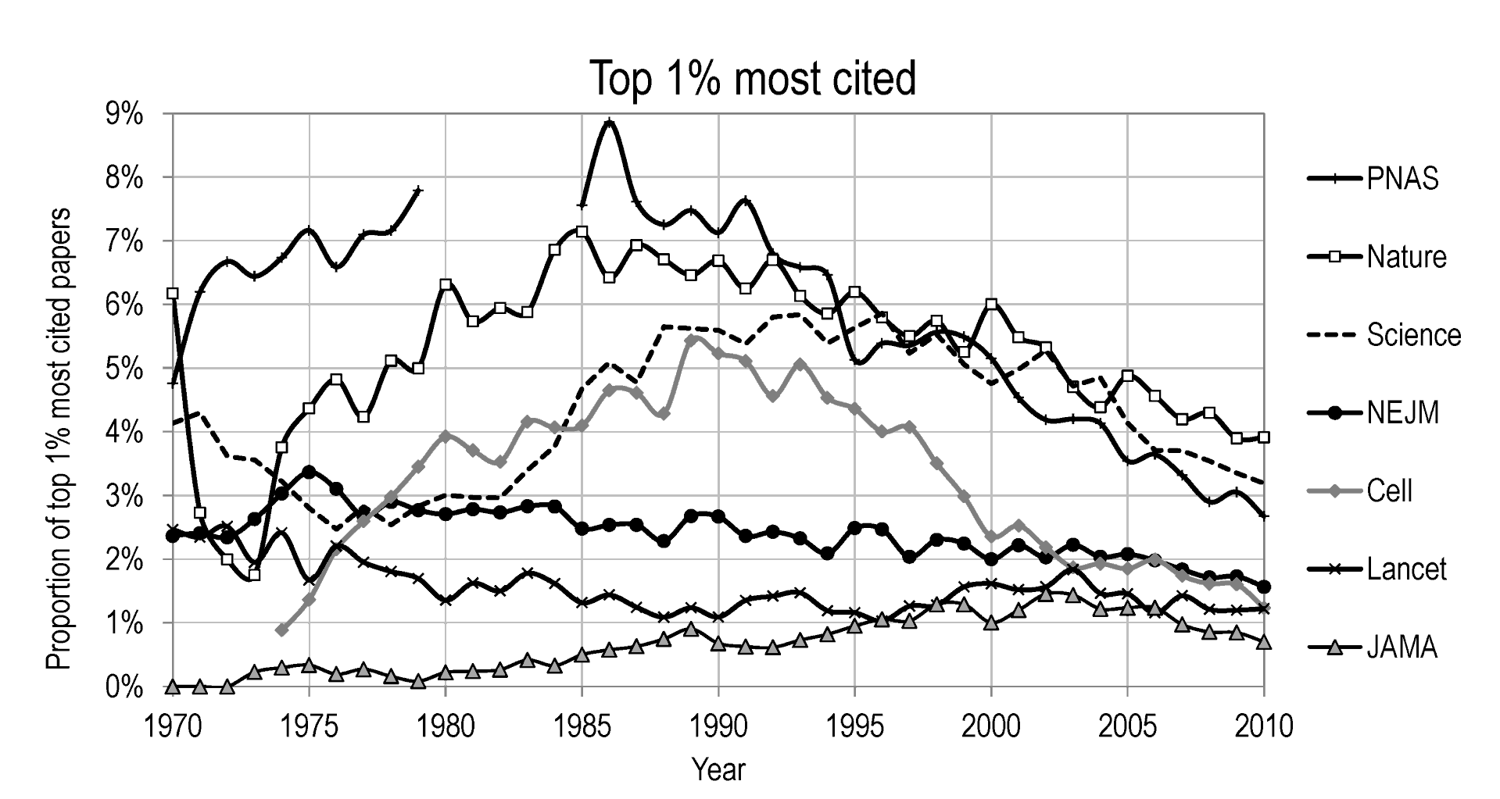
Declining predictive power
Declining share of top 1% most cited papers for elite journals

Slide 19

Impact Factor inflation

Slide 20
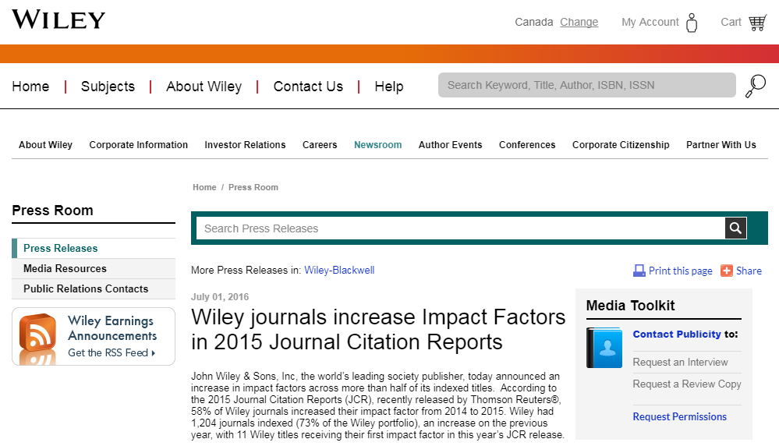
Impact Factor inflation

Slide 21

Impact Factor inflation

Slide 22
Impact Factor inflation
Impact Factor by journal as a function of rank, for years 1997, 2007, and 2016

Slide 23
Post JIF
Five-year Impact Factor (Clarivate Analytics)
Eigenfactor (Clarivate) and SCImago Journal Rank (Scopus)
  Network-based (Google PageRank algorithm)
    Not all citations are equal.
  Differ in data source (size of network), citation window, and inclusion of self-citations
Source Normalized Impact per Paper—SNIP (Scopus)
  “Discipline” of a journal: set of papers citing it.
  Citation potential (length of papers reference’s lists)

Slide 24
Post JIF (2)
CiteScore
  Increase in the citation window (3 year)
  All document considered (i.e. citable and non-citable). Solves the asymmetry.
Criticism:
  Disadvantages journals with a lot of front material
  Advantages Elsevier’s journals
Despite those improvements, the 2-year Clarivate Impact Factor remains the “standard”

Slide 25
Adverse effects
Multiplication of citation indicators
  Dangerous; anyone can find an indicator where one looks better
Pertinence of bibliometrics when ‘transparently’ applied
  « Hawthorne » effect » and change of behavior
  « Taste for papers rather than taste for science »
Scientific fraud and unethical authorship (ghost writing, honorary authorships, etc.)
Predatory publishing

Slide 26
Questions?
Vincent Larivière
Cassidy R. Sugimoto
vincent.lariviere@umontreal.ca
@lariviev
crc.ebsi.umontreal.ca

